Slide 1
CS51530 Programming Languages, Interpreters and Compilers
First Day of Class

Slide 2
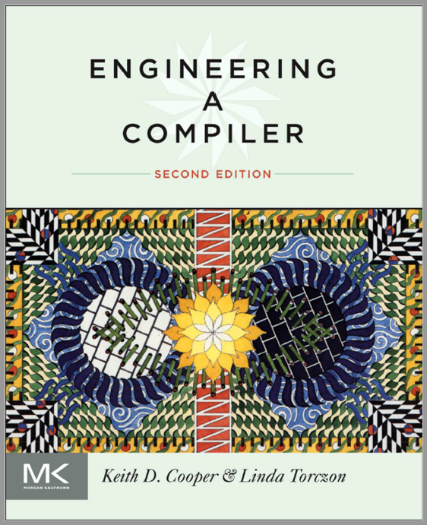
Class Information
Textbook
Brightspace
Projects
Assignment, Quiz
Grade
Email, announcement
Due dates
Syllabus

Slide 3
Chapter 1 Overview of Compilation

Slide 4
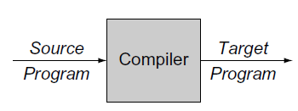
Compiler
A computer program that translate a program written in one language into a program written in another
Typical “source” languages might be C, C++, Fortran, Java, or ML. The “target” language is usually the instruction set of some processor
Compilers that target programming languages rather than the instruction set of a computer are often called source-to-source translators.

Slide 5
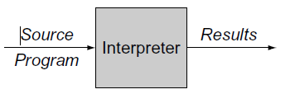
Interpreter
A program that reads an executable program and produces the results of executing that program
C and C++ are typically compiled
Python & Scheme are typically interpreted
Some languages adopt translation schemes that include both compilation and interpretation. For example, Java is
first compiled to bytecode (code for the Java VM )
which are then interpreted
or a hybrid strategy is used
Just-in-time compilation
We focuses on the problems that arise in building compilers. However, an implementor of interpreters may find much of the material relevant.

Slide 6
Why study compilers
Compilers are fundamental
Primary responsibility for application performance
Performance becomes more difficult as processors become more complex. Careful choice of abstractions & where to use them can be the difference between a fast system & a slow (or infeasible) one
Compilers (& interpreters) are everywhere
Many applications have embedded languages
XML, HTML, macros, commands, Visual Basic in Excel, ...
Many applications have input formats that look like languages
Compilers are interesting
Large complicated software systems that must efficiently tackle hard algorithmic problems
approximate solutions to NP complete problems
Application of theory to practice, brings together ideas and techniques from across the breadth of computer science and applies them in a constrained setting to solve some truly hard problems.

Slide 7
The Fundamental Principles of Compilation
The compiler must preserve the meaning of the program being compiled
The compiler must improve the input program in some discernible way.

Slide 8
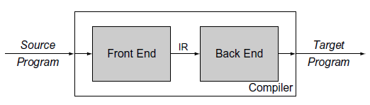
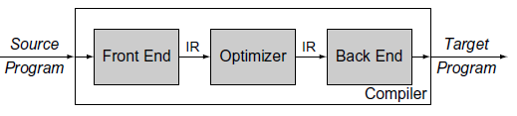
Compiler Structure
Front end analyzes program in source language & builds some internal representation for the program (“IR”)
Back end translates the IR into the target language
Target language is usually the instruction set of some target processor
Two-phase compiler
Three-phase compiler
The optimizer may rewrite the IR in a way that is likely to produce a faster or smaller target program. It may have other objectives, such as a program that produces fewer page faults or uses less energy.

Slide 9
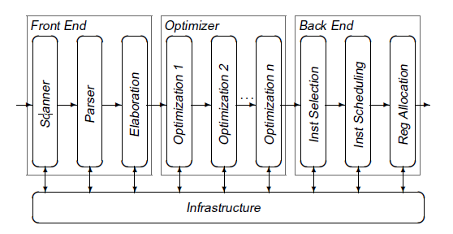
Compiler Structure
In practice, each phase is divided internally into a series of passes.
The front end consists of two or three passes that handle the details of recognizing valid source-language programs and producing the initial IR form of the program.
The middle section contains passes that perform different optimizations. The number and purpose of these passes vary from compiler to compiler.
The back end consists of a series of passes, each of which takes the IR program one step closer to the target machine’s instruction set.

Slide 10
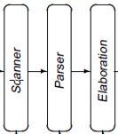
Overview of Translation: Front End
source
code
Front End
IR
Optimizer
IR
Back End
target
code
Scanner looks at every character
Converts stream of chars to stream of classified words:
<word, part of speech>
We sometimes call it a “token”
Efficiency & scalability matter
Parser looks at every token
Determines if the stream of tokens forms a sentence in the source language
Fits tokens to some syntactic model, or grammar, for the source language
Semantic Elaboration performs analysis that is deeper than syntax
E.g., build an IR, layout storage, do type checking, …

Slide 11
Overview of Translation: Front End
Two-dimensional Array
loadI | 4 | — | r₁
load | r₁ | — | r₂
add | r₁ | r₂ | r₃
Original Code
loadI | 4 | => r₁
load | r₁ | => r₂
add | r₁ , r₂ | => r₃
might be represented as either
Linked List
loadI | 4 | — | r₁
load | r₁ | — | r₂
add | r₁ | r₂ | r₃
Scanning & Parsing tell us if the input is well formed.
To work on the code, we need a concrete representation for it.
The design of an IR has major consequences for the rest of the compiler
Compiler cannot easily manipulate what it does not represent
Different data structures have different cost structures
Common operations should be cheap & easy

Slide 12
Overview of Translation: the Optimizer
Most optimizations consist of an analysis and a transformation.
Compilers use several kinds of analysis to support transformations.
Data flow analysis reasons, at compile time, about the flow of values at runtime.
Transformation uses the results of analysis to rewrite the code into a more efficient form.
Transformations vary in their effect, the scope over which they operate, and the analysis required to support them.

Slide 13
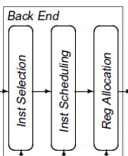
Overview of Translation: The Back End
source
code
Front End
IR
Optimizer
IR
Back End
target
code
Instruction selection maps each IR operation, in its context, into one or more target machine operations.
The instruction selector can take advantage of special operations on the target machine.
The instruction scheduler reorders the operations in the code. It attempts to minimize the number of cycles wasted waiting for operands.
Register Allocator decides, at each operation, which values reside in registers

Slide 14
Road Map of the Class
Chapters 2 through 4, covers both the design of a compiler front end and the design and construction of tools to build front ends.
Chapters 5 through 7, explores the mapping of source-code into the compiler’s intermediate form—that is, these chapters examine the kind of code that the front end generates for the optimizer and back end.
Chapters 8 through 10, introduces the subject of code optimization.
Chapters 11 through 13, focuses on algorithms used in the compiler’s back end.

Slide 15
Group Discussion
Introduce yourself
Name some programming languages that you are familiar with
What special features that you like/dislike about the language
Are they interpreted or compiler?
What compilers have you used?
Have you used compiler optimization?
Any experience with compiler construction?

